Slide 1
Chapter 1 Introduction to Computers, Programs, and Java

Slide 2
Objectives
To understand computer basics, programs, and operating systems (§§1.2–1.4).
To describe the relationship between Java and the World Wide Web (§1.5).
To understand the meaning of Java language specification, API, JDK, and IDE (§1.6).
To write a simple Java program (§1.7).
To display output on the console (§1.7).
To explain the basic syntax of a Java program (§1.7).
To create, compile, and run Java programs (§1.8).
To use sound Java programming style and document programs properly (§1.9).
To explain the differences between syntax errors, runtime errors, and logic errors (§1.10).

Slide 3

What is a Computer?
A computer consists of a CPU, memory, hard disk, floppy disk, monitor, printer, and communication devices.

Slide 4

CPU
The central processing unit (CPU) is the brain of a computer. It retrieves instructions from memory and executes them. The CPU speed is measured in megahertz (MHz), with 1 megahertz equaling 1 million pulses per second. The speed of the CPU has been improved continuously. If you buy a PC now, you can get an Intel Pentium (Kaby Lake) Processor at 4.2 gigahertz (1 gigahertz is 1000 megahertz).

Slide 5

Memory
Memory (i.e., Random Access Memory, or RAM) stores data and program instructions for the CPU to execute. A memory unit is an ordered sequence of bytes. Each byte holds eight bits. A program and its data must be loaded into memory before they can be executed. A byte is never empty, but its initial content may be meaningless to your program. The current content of a byte is lost whenever new information is placed in it.

Slide 6

How Data is Stored?
Data of various kinds, such as numbers, characters, and strings, are encoded as a series of bits (zeros and ones). Computers use zeros and ones because digital devices have two stable states, which are referred to as zero and one by convention. The programmers need not be concerned about the encoding and decoding of data, which is performed automatically by the system based on the encoding scheme. The encoding scheme varies. For example, character ‘J’ is represented by 01001010 in one byte. A small number such as three can be stored in a single byte. If a computer needs to store a large number that cannot fit into a single byte, it uses a number of adjacent bytes. Typically, it is not possible to allocate less than one byte (say, one bit) for a single purpose. A byte is the minimum storage unit.

Slide 7

Storage Devices
Memory is volatile, because information is lost when the power is off. Programs and data are permanently stored on storage devices and are loaded into memory when the computer actually uses them. There are four main types of storage devices: Solid State Drives (SSDs), Disk drives (hard disks and floppy disks), CD drives (CD-R and CD-RW), and Tape drives.

Slide 8

Output Devices: Monitor
The monitor displays information (text and graphics). The resolution and dot pitch determine the quality of the display.

Slide 9
Monitor Resolution and Dot Pitch
resolution
The screen resolution specifies the number of pixels in horizontal and vertical dimensions of the display device. Pixels (short for “picture elements”) are tiny dots that form an image on the screen. A common resolution is 1920 pixels wide and 1080 pixels high. The resolution can be set manually (up to the native resolution of the monitor). The higher the resolution, the sharper and clearer the image is.
dot pitch
The dot pitch is the amount of space between pixels, measured in millimeters. The smaller the dot pitch, the sharper the display.

Slide 10

Communication Devices
A regular modem uses a phone line and can transfer data in a speed up to 56,000 bps (bits per second). A DSL (digital subscriber line) also uses a phone line and can transfer data between 100 times faster (5.6 Mbps) and 1000 times (56 Mbps) faster than a regular modem. A cable modem uses the TV cable line maintained by the cable company. A cable modem is as fast or, typically, faster than a DSL. Network interface card (NIC) is a device to connect a computer to a local area network (LAN). The LAN is commonly used in business, universities, and government organizations. A typical type of NIC, called 10BaseT, can transfer data at 10 Mbps (million bits per second).

Slide 11
Programs
Computer programs, known as software, are instructions to the computer.
You tell a computer what to do through programs. Without programs, a computer is an empty machine. Computers do not understand human languages, so you need to use computer languages to communicate with them.
Programs are written using programming languages.

Slide 12
Programming Languages
Machine Language Assembly Language High-Level Language
Machine language is a set of primitive instructions built into every computer. The instructions are in the form of binary code, so you have to enter binary codes for various instructions. Programming with native machine language is a tedious process. Moreover the programs are highly difficult to read and modify. For example, to add two numbers, you might write an instruction in binary like this:
  1101101010011010

Slide 13
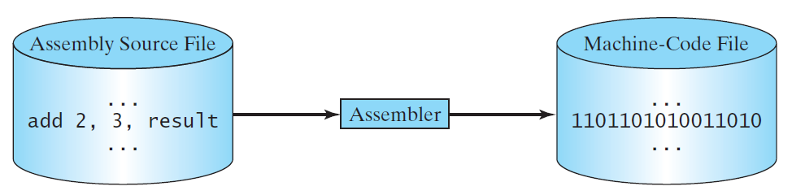
Programming Languages
Machine Language Assembly Language High-Level Language
Assembly languages were developed to make programming easy. Since the computer cannot understand assembly language, however, a program called an assembler is used to convert assembly language programs into machine code. For example, to add two numbers, you might write an instruction in assembly code like this:
ADDF3 R1, R2, R3

Slide 14
Programming Languages
Machine Language Assembly Language High-Level Language
The high-level programming languages are English-like and easy to learn and program. For example, the following is a high-level language statement that computes the area of a circle with radius 5:
area = 5 * 5 * 3.1415;

Slide 15

Popular High-Level Languages

Slide 16
Interpreting/Compiling Source Code
A program written in a high-level language is called a source program or source code. Because a computer cannot understand a source program, a source program must be translated into machine code for execution. The translation can be done using another programming tool called an interpreter or a compiler.

Slide 17

Interpreting Source Code
An interpreter reads one statement from the source code, translates it to the machine code or virtual machine code, and then executes it right away, as shown in the following figure. Note that a statement from the source code may be translated into several machine instructions.

Slide 18

Compiling Source Code
A traditional compiler translates the entire source code into a machine-code file, and the machine-code file is then executed, as shown in the following figure.

Slide 19
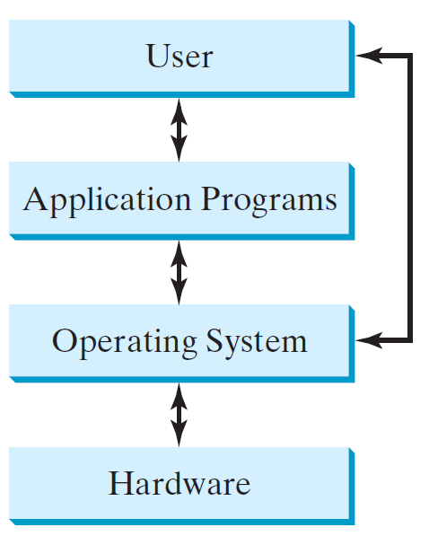
Operating Systems
The operating system (OS) is a program that manages and controls a computer’s activities. The popular operating systems for general-purpose computers are Microsoft Windows, Mac OS, and Linux. Application programs, such as a Web browser or a word processor, cannot run unless an operating system is installed and running on the computer.

Slide 20
Why Java?
The answer is that Java enables users to develop and deploy applications on the Internet for servers, desktop computers, and small hand-held devices. The future of computing is being profoundly influenced by the Internet, and Java promises to remain a big part of that future. Java is the Internet programming language.
Java is a general purpose programming language.
Java is the Internet programming language.

Slide 21
Java, Web, and Beyond
Java can be used to develop standalone applications.
Java can be used to develop applications running from a browser.
Java can also be used to develop applications for hand-held devices.
Java can be used to develop applications for Web servers.

Slide 22
Characteristics of Java
Companion Website
Java Is Simple
Java Is Object-Oriented
Java Is Distributed
Java Is Interpreted
Java Is Robust
Java Is Secure
Java Is Architecture-Neutral
Java Is Portable
Java's Performance
Java Is Multithreaded
Java Is Dynamic
www.cs.armstrong.edu/liang/JavaCharacteristics.pdf

Slide 23
JDK Versions
JDK 1.02 (1995)
JDK 1.1 (1996)
JDK 1.2 (1998)
JDK 1.3 (2000)
JDK 1.4 (2002)
JDK 1.5 (2004) a. k. a. JDK 5 or Java 5
JDK 1.6 (2006) a. k. a. JDK 6 or Java 6
JDK 1.7 (2011) a. k. a. JDK 7 or Java 7
JDK 1.8 (2014) a. k. a. JDK 8 or Java 8

Slide 24
JDK Editions
Java Standard Edition (J2SE)
  J2SE can be used to develop client-side standalone applications or applets.
Java Enterprise Edition (J2EE)
  J2EE can be used to develop server-side applications such as Java servlets, Java ServerPages, and Java ServerFaces.
Java Micro Edition (J2ME).
  J2ME can be used to develop applications for mobile devices such as cell phones.
This book uses J2SE to introduce Java programming.

Slide 25
A Simple Java Program
Listing 1.1
// This program prints Welcome to Java!
public class Welcome {
public static void main(String[] args) {
System.out.println("Welcome to Java!");
}
}
Note: Clicking the green button displays the source code with interactive animation. You can also run the code in a browser. Internet connection is needed for this button.
Welcome

Slide 26
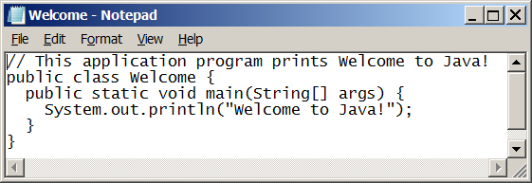
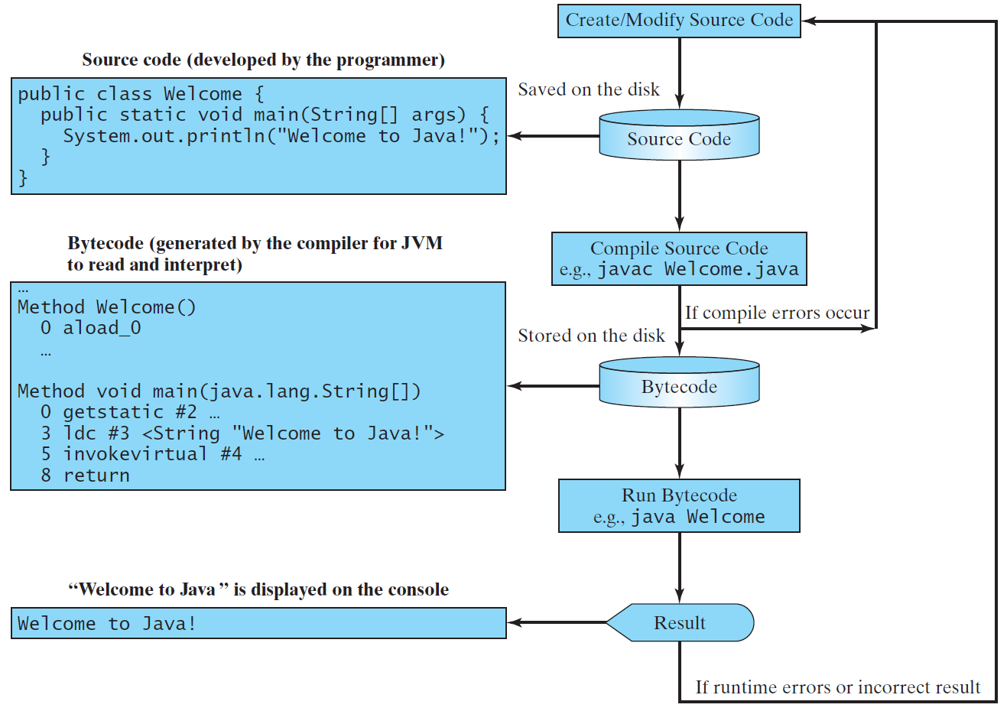
Creating, Compiling, and Running Programs

Slide 27
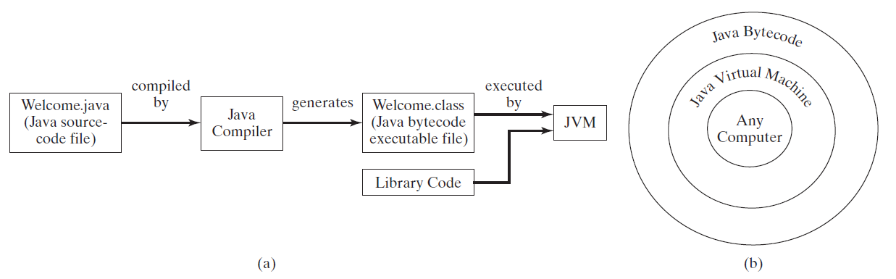
Compiling Java Source Code
When using traditional compilers which output machine code directly, you can port a source program to any machine for which a compiler has been developed. The source program must be recompiled, however, because the machine code can only run on a specific machine.
Java was designed to run object programs on any platform. With Java, you write the program once, and compile the source program into a special type of object code, known as bytecode. The bytecode can then run on any computer with a Java Virtual Machine, as shown below. Java Virtual Machine is a software that interprets Java bytecode.

Slide 28
Trace a Program Execution
animation
Enter main method
// This program prints Welcome to Java!
public class Welcome {
public static void main(String[] args) {
System.out.println("Welcome to Java!");
}
}

Slide 29
Trace a Program Execution
animation
Execute statement
// This program prints Welcome to Java!
public class Welcome {
public static void main(String[] args) {
System.out.println("Welcome to Java!");
}
}

Slide 30

Trace a Program Execution
animation
// This program prints Welcome to Java!
public class Welcome {
public static void main(String[] args) {
System.out.println("Welcome to Java!");
}
}
print a message to the console

Slide 31
Two More Simple Examples
WelcomeWithThreeMessages
ComputeExpression

Slide 32
Anatomy of a Java Program
Class name
Main method
Statements
Statement terminator
Reserved words
Comments
Blocks

Slide 33
Class Name
Every Java program must have at least one class. Each class has a name. By convention, class names start with an uppercase letter. In this example, the class name is Welcome.
// This program prints Welcome to Java!
public class Welcome {
public static void main(String[] args) {
System.out.println("Welcome to Java!");
}
}

Slide 34
Main Method
Line 2 defines the main method. In order to run a class, the class must contain a method named main. The program is executed from the main method.
// This program prints Welcome to Java!
public class Welcome {
public static void main(String[] args) {
System.out.println("Welcome to Java!");
}
}

Slide 35
Statement
A statement represents an action or a sequence of actions. The statement System.out.println("Welcome to Java!") in the program in Listing 1.1 is a statement to display the greeting "Welcome to Java!“.
// This program prints Welcome to Java!
public class Welcome {
public static void main(String[] args) {
System.out.println("Welcome to Java!");
}
}

Slide 36
Statement Terminator
Every statement in Java ends with a semicolon (;).
// This program prints Welcome to Java!
public class Welcome {
public static void main(String[] args) {
System.out.println("Welcome to Java!");
}
}

Slide 37
Reserved words
Reserved words or keywords are words that have a specific meaning to the compiler and cannot be used for other purposes in the program. For example, when the compiler sees the word class, it understands that the word after class is the name for the class.
// This program prints Welcome to Java!
public class Welcome {
public static void main(String[] args) {
System.out.println("Welcome to Java!");
}
}

Slide 38

Blocks
A pair of braces in a program forms a block that groups components of a program.

Slide 39

Special Symbols

Slide 40
{ … }
// This program prints Welcome to Java!
public class Welcome {
public static void main(String[] args) {
System.out.println("Welcome to Java!");
}
}

Slide 41
( … )
// This program prints Welcome to Java!
public class Welcome {
public static void main(String[] args) {
System.out.println("Welcome to Java!");
}
}

Slide 42
;
// This program prints Welcome to Java!
public class Welcome {
public static void main(String[] args) {
System.out.println("Welcome to Java!");
}
}

Slide 43
// …
// This program prints Welcome to Java!
public class Welcome {
public static void main(String[] args) {
System.out.println("Welcome to Java!");
}
}

Slide 44
" … "
// This program prints Welcome to Java!
public class Welcome {
public static void main(String[] args) {
System.out.println("Welcome to Java!");
}
}

Slide 45
Programming Style and Documentation
Appropriate Comments
Naming Conventions
Proper Indentation and Spacing Lines
Block Styles

Slide 46
Appropriate Comments
Include a summary at the beginning of the program to explain what the program does, its key features, its supporting data structures, and any unique techniques it uses.
Include your name, class section, instructor, date, and a brief description at the beginning of the program.

Slide 47
Naming Conventions
Choose meaningful and descriptive names.
Class names:
  Capitalize the first letter of each word in the name. For example, the class name ComputeExpression.

Slide 48
Proper Indentation and Spacing
Indentation
  Choose the number of spaces you will indent. (Typically 2, 3 or 4. By default, BlueJ auto-indents 4 spaces.) Consistently indent by that many spaces.
Blank lines
  Use blank line to separate segments of the code.

Slide 49

Block Styles
Use next-line style or end-of-line style for braces.

Slide 50
Programming Errors
Syntax Errors
  Detected by the compiler
Runtime Errors
  Causes the program to abort
Logic Errors
  Produces incorrect result

Slide 51
Syntax Errors
public class ShowSyntaxErrors {
public static main(String[] args) {
System.out.println("Welcome to Java);
}
}
ShowSyntaxErrors

Slide 52
Runtime Errors
public class ShowRuntimeErrors {
public static void main(String[] args) {
System.out.println(1 / 0);
}
}
ShowRuntimeErrors

Slide 53
Logic Errors
public class ShowLogicErrors {
public static void main(String[] args) {
System.out.println("Celsius 35 is Fahrenheit degree ");
System.out.println((9 / 5) * 35 + 32);
}
}
ShowLogicErrors

